Slide 1
One VA Pharmacy VA118-15-Q-0745
VAeMI Middleware Mitigation Option
10 February 2016
Birali Hakizumwami – OneVA Pharmacy Architect

Slide 2
Agenda
OneVA Pharmacy Timeline
OneVA Pharmacy Architecture
VAeMI Middleware Pros/Cons
Proposed Mitigation Option
Proposed Mitigation Option Architecture
Proposed Mitigation Option Pros/Cons
Proposed Mitigation Option Timeline
Open Discussion

Slide 3
OneVA Pharmacy Timeline
Development/Integration/User Functional Testing *
Start: 15 February 2016
End: 31 March 2016
Initial Operating Capability (IOC) Evaluation **
Start: 21 April 2016
End: 16 June 2016
Hand off to Existing Product Intake Program (EPIP) **
Start: 01 July 2016
End: 01 August 2016
Production Support (National Rollout) **
Start: 01 August 2016
* Requires VAeMI Middleware to be in development/testing environments available for OneVA Pharmacy Team
** Requires VAeMI Middleware to be in Production / Enterprise environment

Slide 4
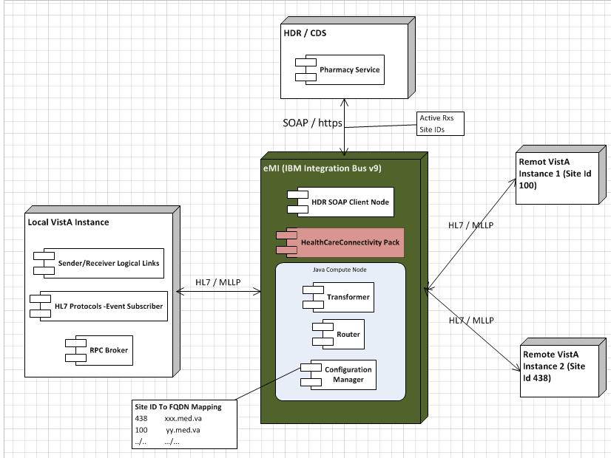
OneVA Pharmacy Architecture

Slide 5
VAeMI Middleware Pros/Cons
Pros
Aligned with the VA Technical Reference Model (TRM) architecture (using approved, architected solution)
No migration risk
Uses industry Service Oriented Architecture (SOA) standards
eMI platform runs on IBM stack which is already licensed for the VA
Cons
OneVA Pharmacy Production / Enterprise project timelines does not fit with the VAeMI released timelines (already published)
e.g. IOC Site Evaluation dates
Time to setup the VAeMI environments for self-service project: Development/Integration Testing/Production will not be ready for OneVA Pharmacy development and integration testing schedule.

Slide 6
VAeMI Proposed Mitigation Option
Assessing the possibility of employing a temporary Approved Open Source Enterprise Service Bus (ESB) solution for OneVA Pharmacy
e.g. Mirth Connect, MULE
Assess the possibility of using VistA Link 2.0 once available

Slide 7
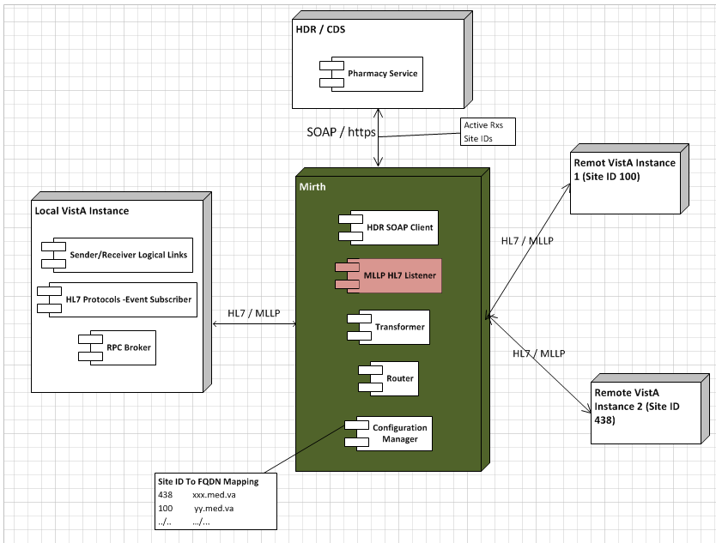
Proposed Mitigation Option Architecture

Slide 8
Proposed Option: Mirth Connect or MULE Pros/Cons
Pros
Technology Approved on the VA TRM (using approved VA software)
Light weight with built-in MLLP connecter; No licensing fees; Uses industry SOA standards
Components developed can be easily ported to the IBM IB9 as Java compute Nodes
Easy to install once a Virtual Machine (VM) is provisioned at the Austin Information Technology Center (AITC)
Timelines fit within the tight schedule of the OneVA Pharmacy project; Project will finish on time.
There is no licensing cost
Cons
Does not align with the VA end-state Enterprise Messaging Architecture
Server resources & people resources necessary to obtain hardware and support (e.g. Administration rights)
Ongoing sustainment costs/ownership
A migration cost is incurred when VAeMI is ready for OneVA Pharmacy to migrate over

Slide 9
Proposed Mitigation Option Timeline
Development/Integration/User Functional Testing *
Start: 15 February 2016
End: 31 March 2016
Allocate development servers – 3 days; OneVA Pharmacy code migration – 5 days; OneVA Pharmacy integration and development – 4 weeks; Allocate testing servers – 3 days; Allocate production servers – 2 weeks
Initial Operating Capability (IOC) Evaluation **
Start: 21 April 2016
End: 16 June 2016
Hand off to Existing Product Intake Program (EPIP) **
Start: 01 July 2016
End: 01 August 2016
Production Support (National Rollout) **
Start: 01 August 2016
* Requires Mirth/Mule to be in development/testing environments available for OneVA Pharmacy Team
** Requires Mirth/Mule to be in Production / Enterprise environment

Slide 10
Open Discussion

